Slide 1
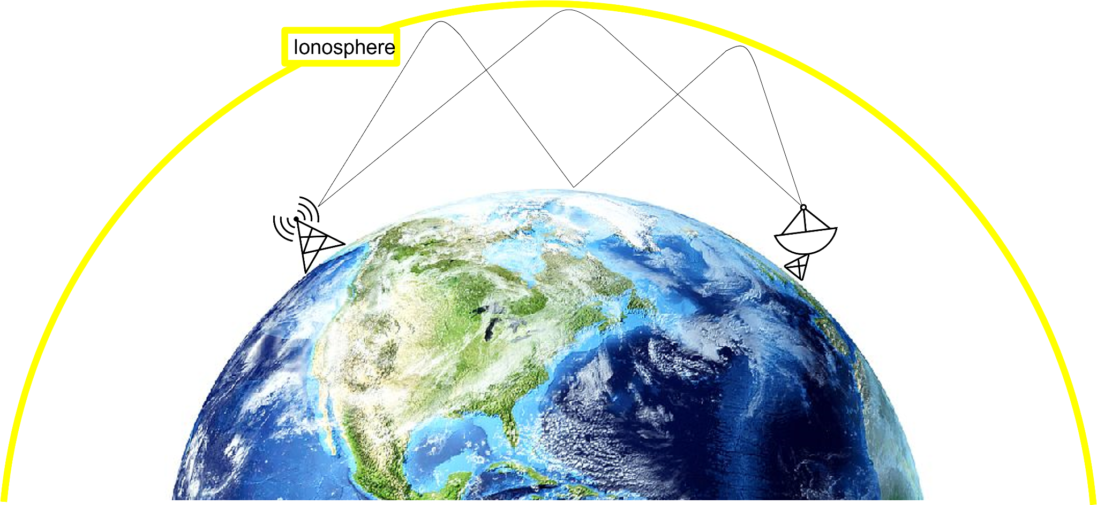
Project 3
How to turn measurements into an analytical model
Benjamin Biewald, Timur Mulic, Nadine Barth, Ryan Wickremasinghe
Supervisor: Dr. David Wenzel

Slide 2
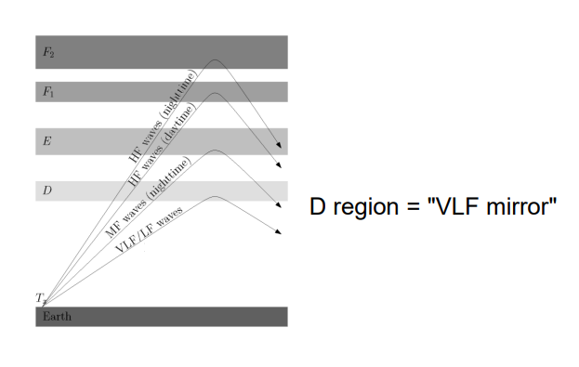
Why VLF Data
0,1s Intervals

Slide 3
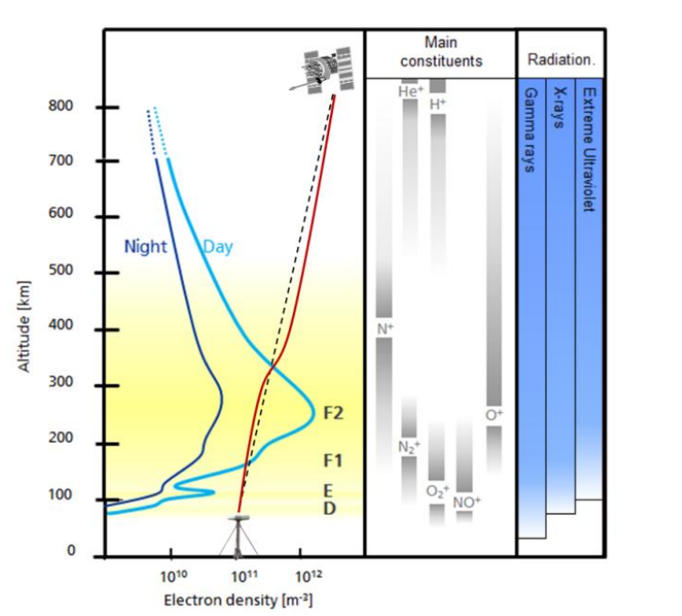
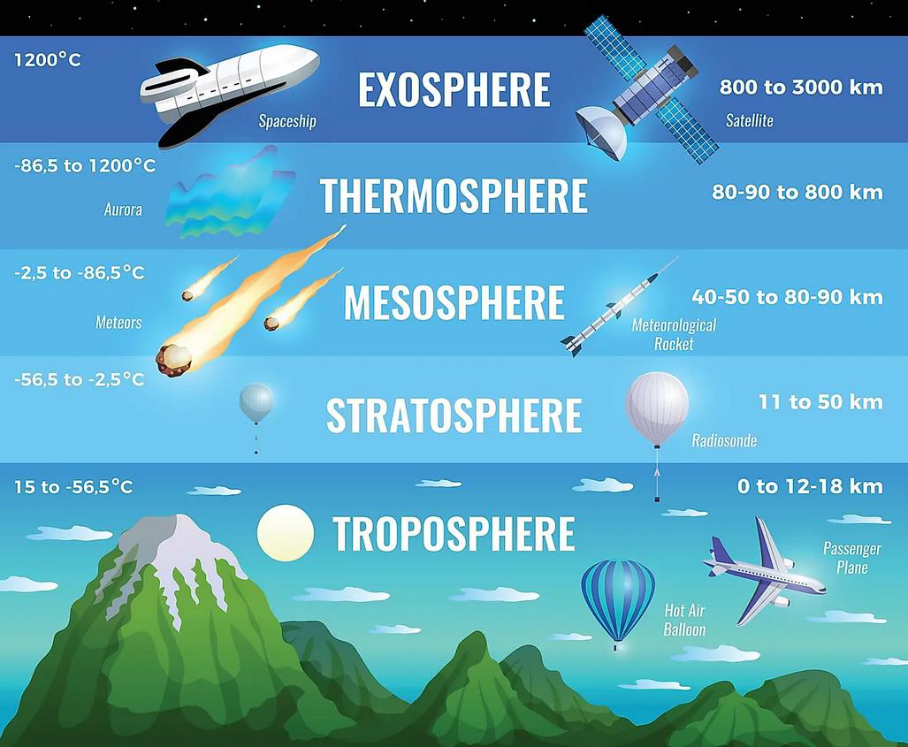
D Layer

Slide 4

Reflection at the Ionosphere

Slide 5
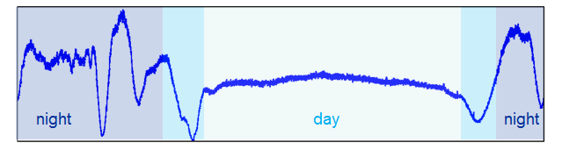
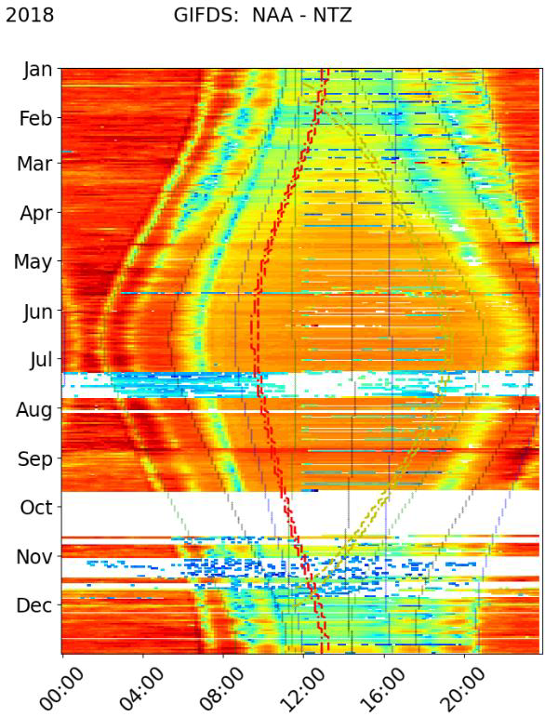
VLF Diurnal Variations
VLF Seasonal Variations

Slide 6
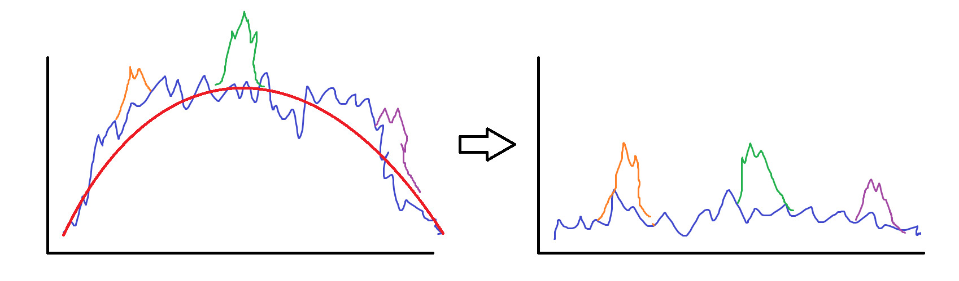
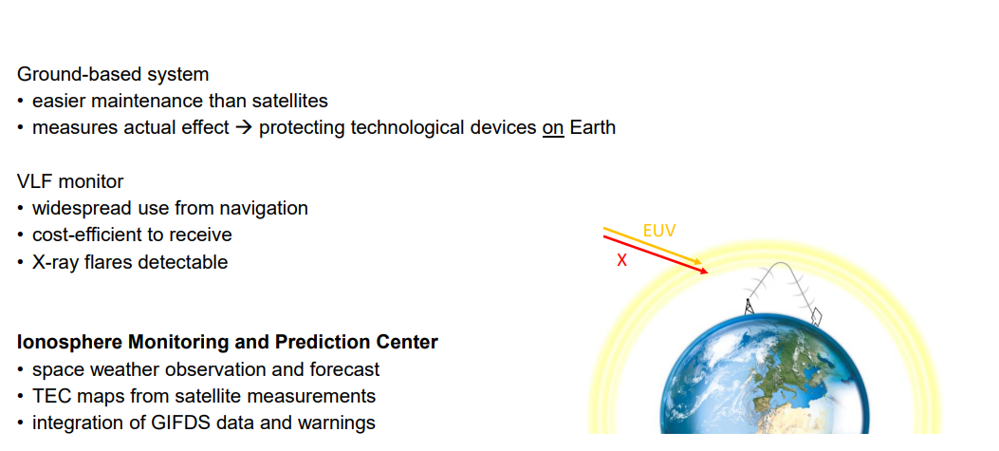
GOAL:

Slide 7
Data aquisition

Slide 8
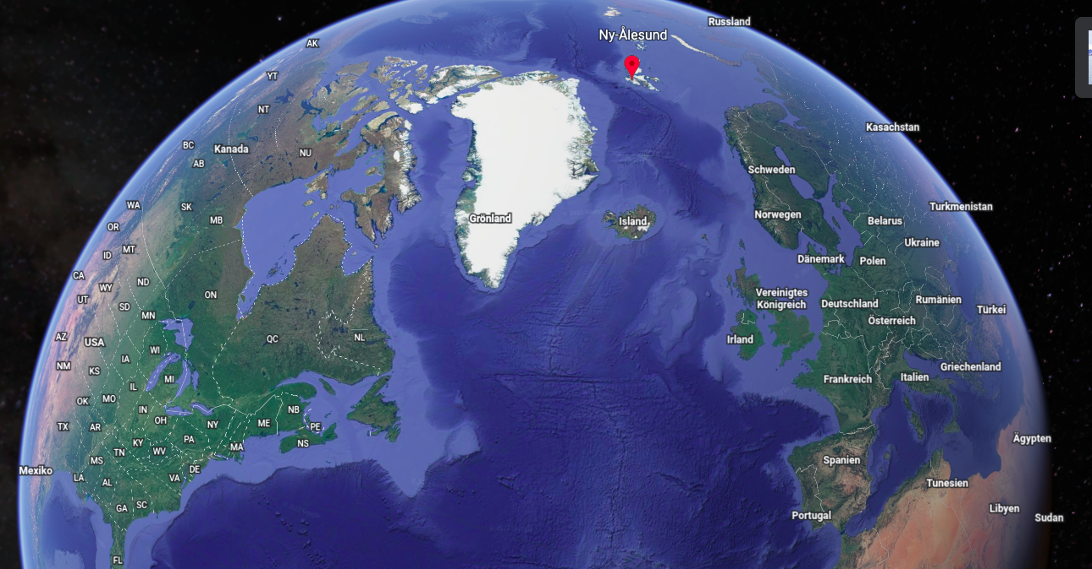
Transmitter and Receiver
NRK
NLK
DHO
NAA

Slide 9
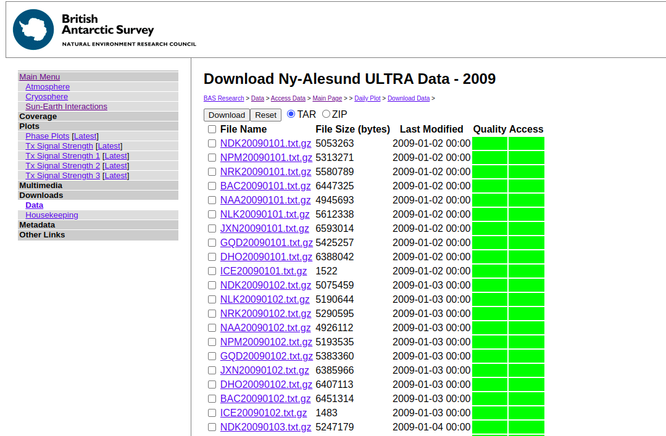
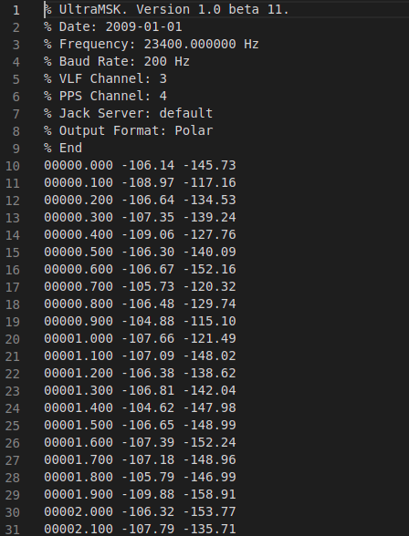
Data acquisition
Amplitude
Phase
TOD
http://psddb.nerc-bas.ac.uk/data/access/download.php?searchterm=ultra&page=4&cat=item&
year=2009&class=232&type=ULTRA&site=Ny-Alesund&v=Data

Slide 10
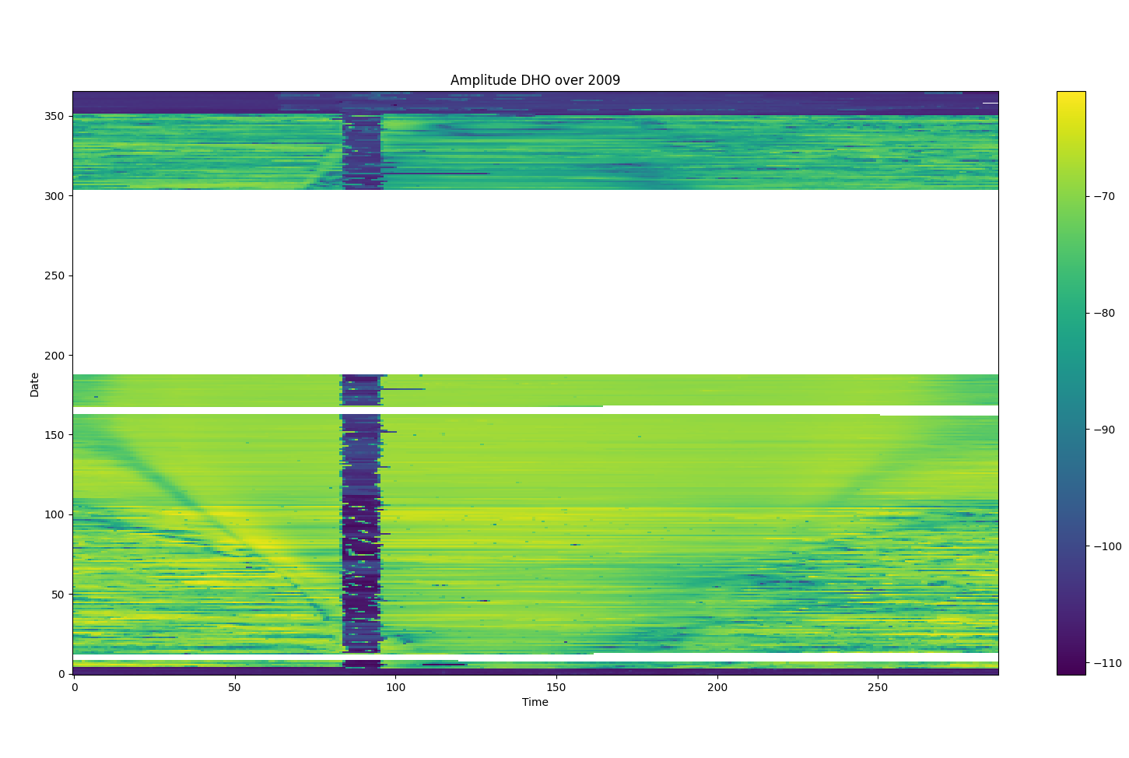
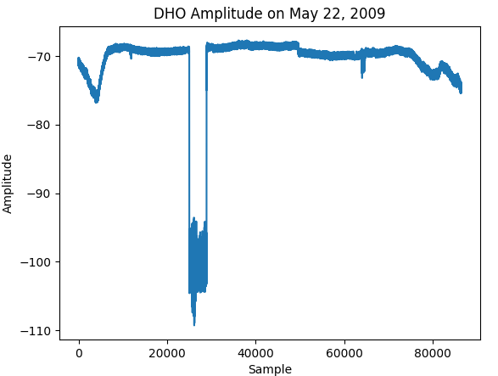
Data
What’s this?

Slide 11
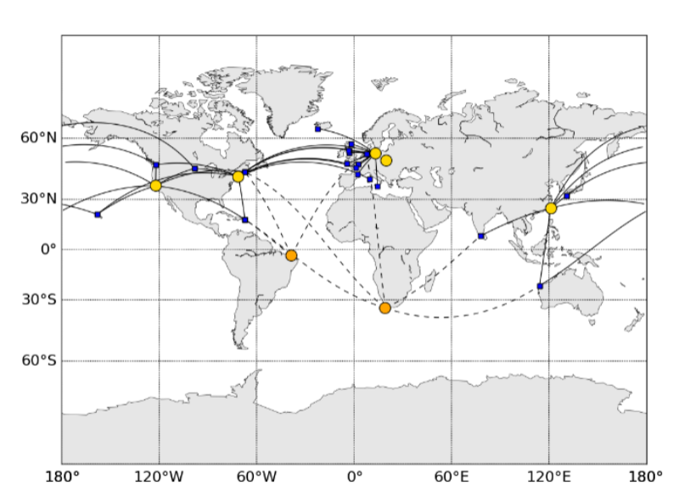
GIFDS Network
VLF receivers continously monitoring several transmitters
detect so-called solar flares
study influence of solar irradiation

Slide 12
GIFDS Network

Slide 13
Methods

Slide 14
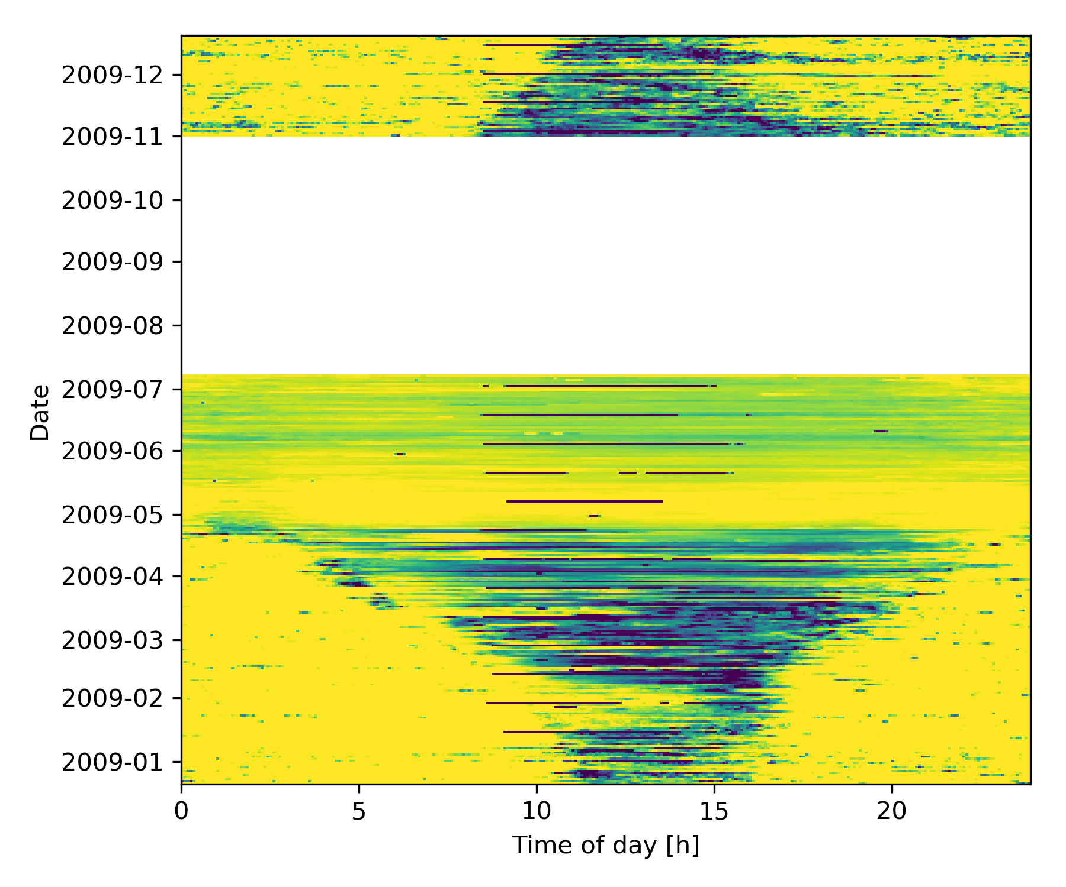
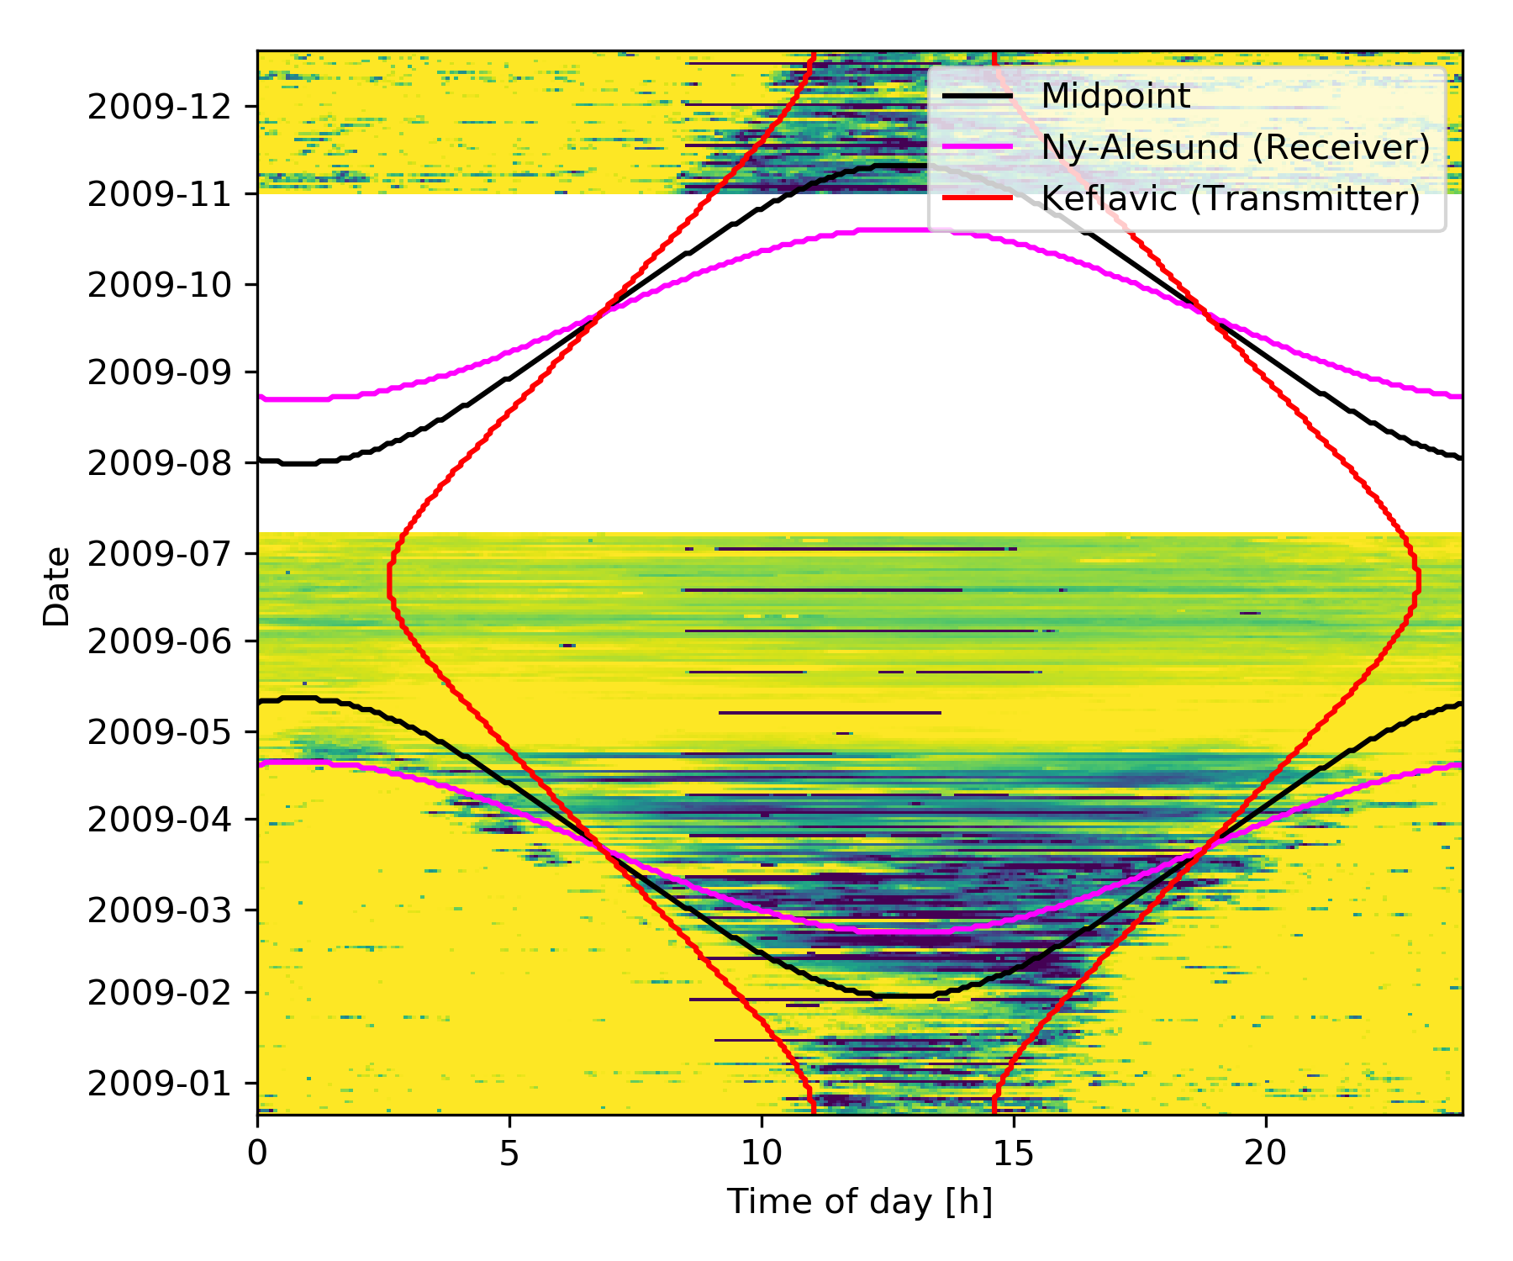
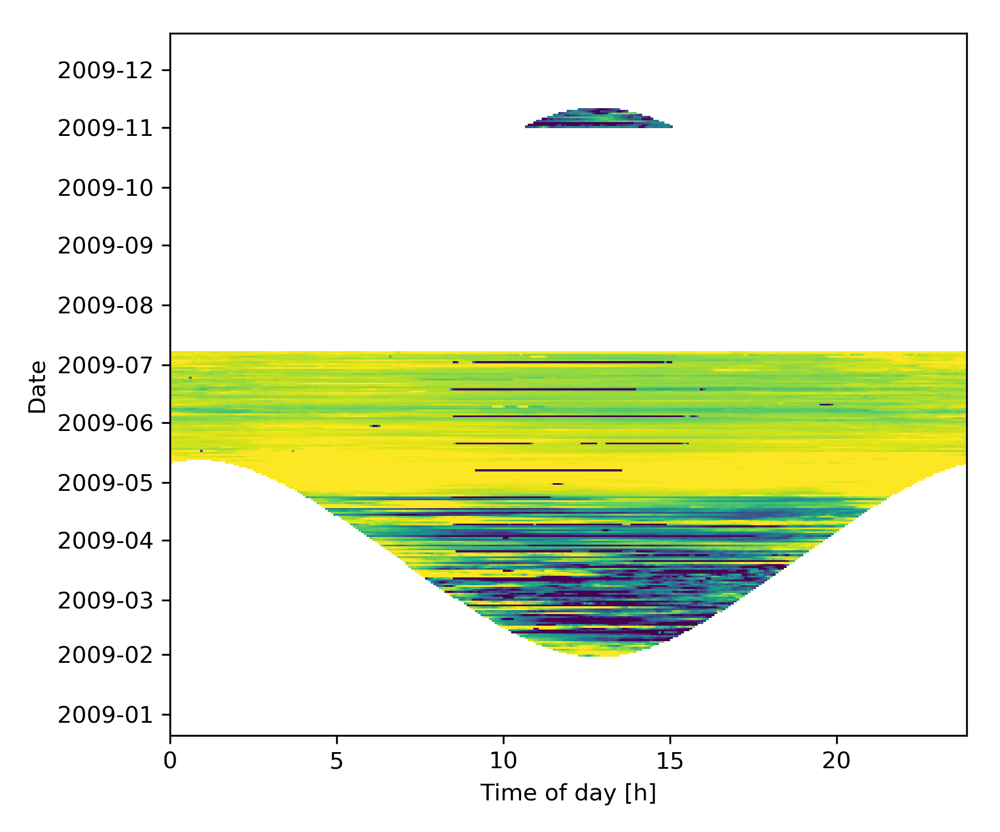


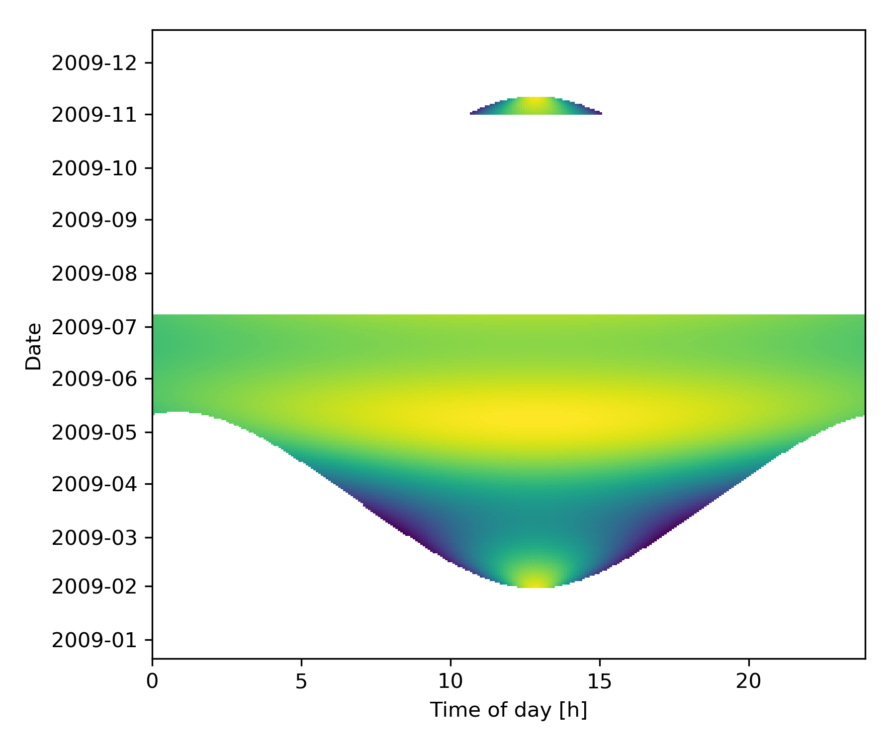

Slide 15
Truncate the Night

Slide 17
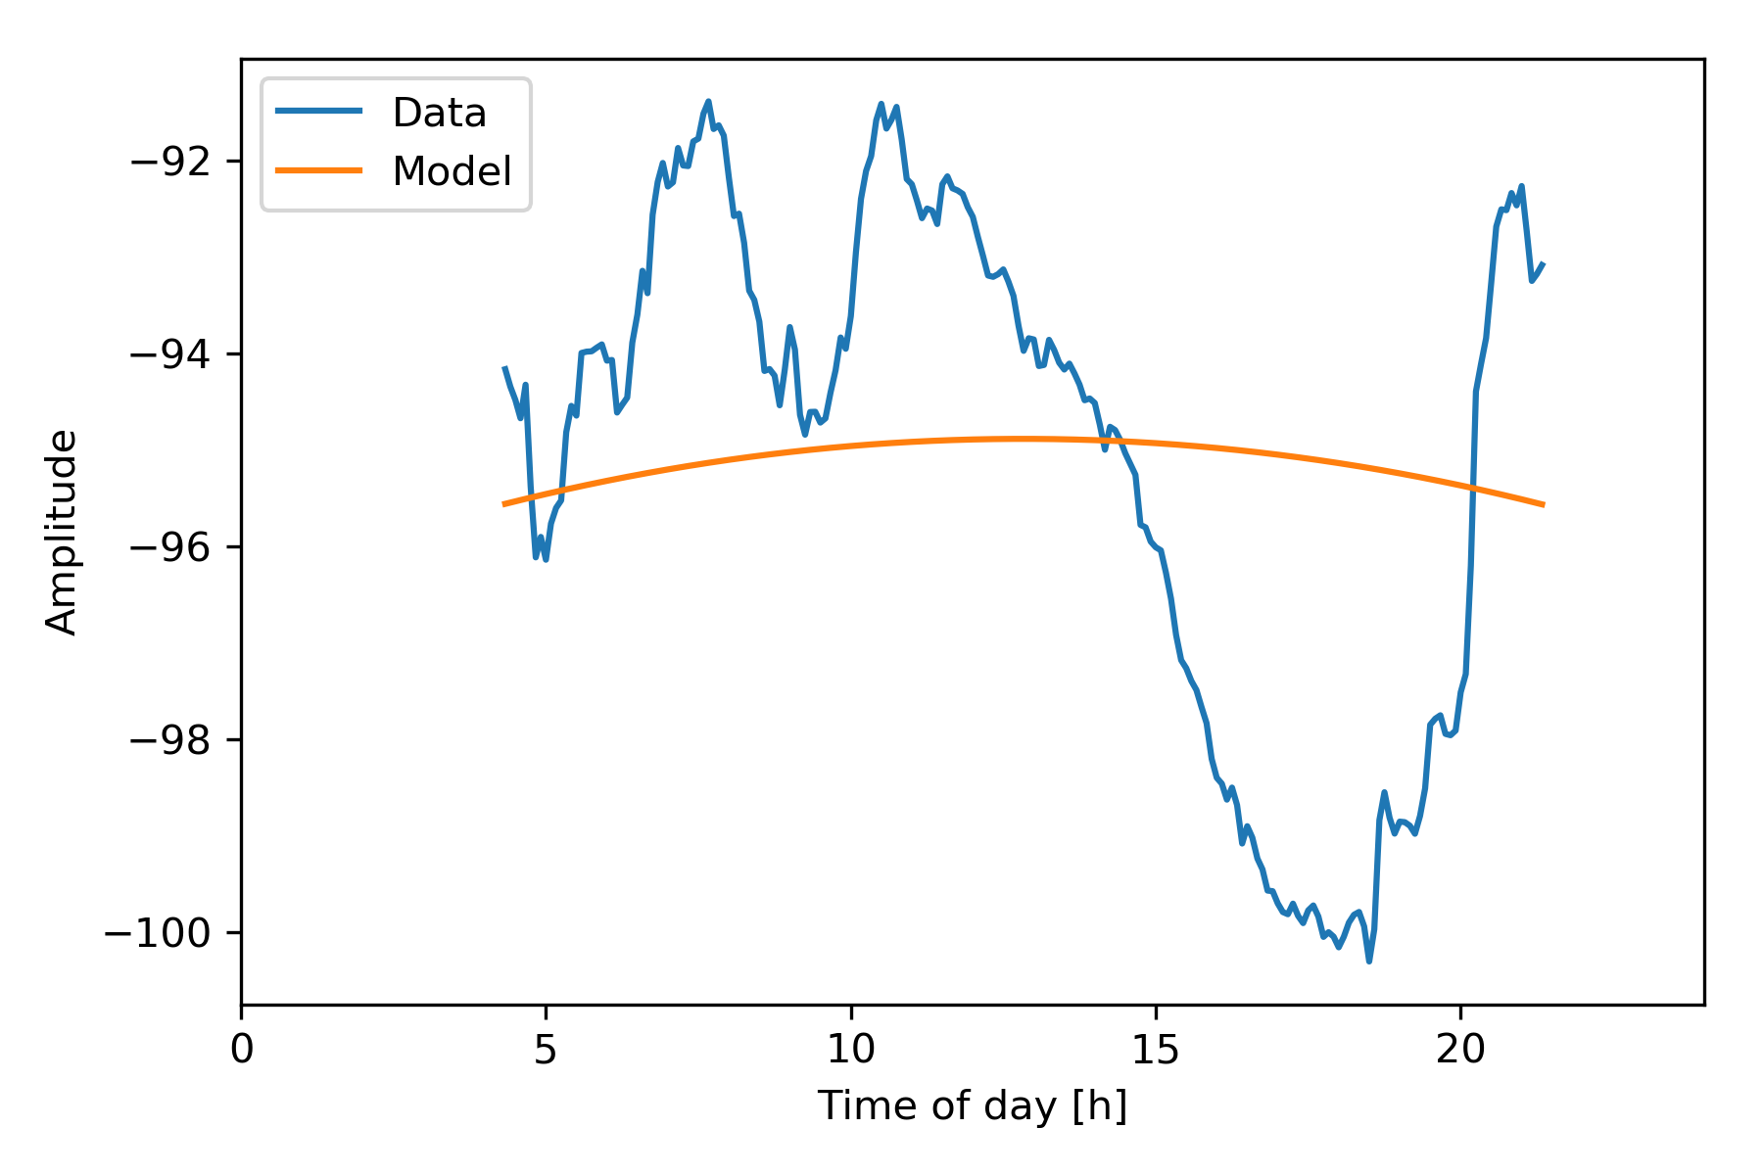
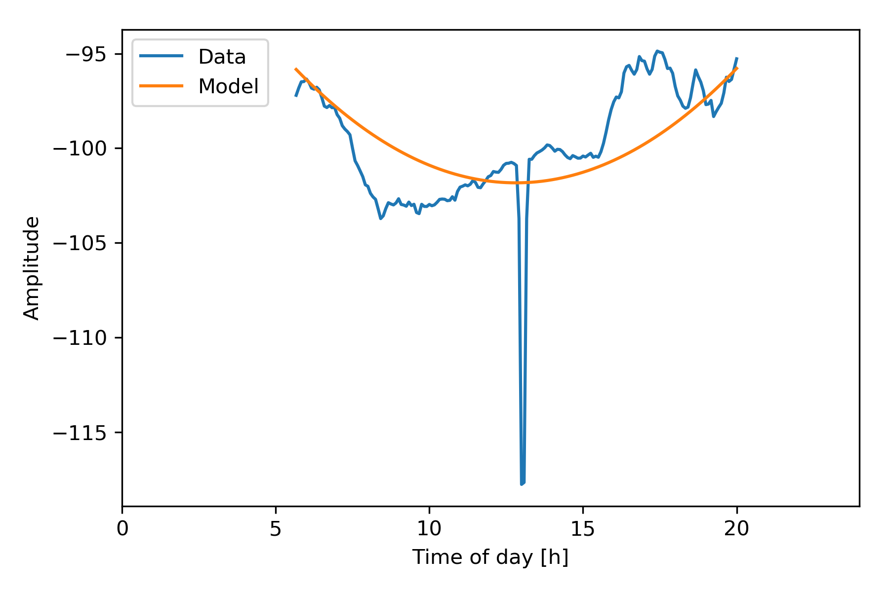
Smooth out diurnal influences
Amp(ToD) = A + C * ToD^2
Maintenance
-> Approximate the Curve with Linear Least Squares Method
Peaks
-> Outlier Detection

Slide 19
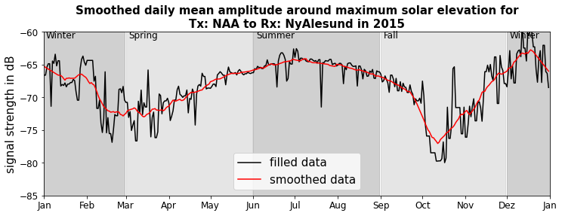
Smooth the seasonal data over the year

Slide 20
Resulting Model - In General
Amp(ToD) = A + C* ToD^2
Amp(DoY,ToD) = A(DoY) + C(DoY) * ToD^2
DoY = Day of Year
ToD = Time of Day
Amp = Modeled Amplitude

Slide 21
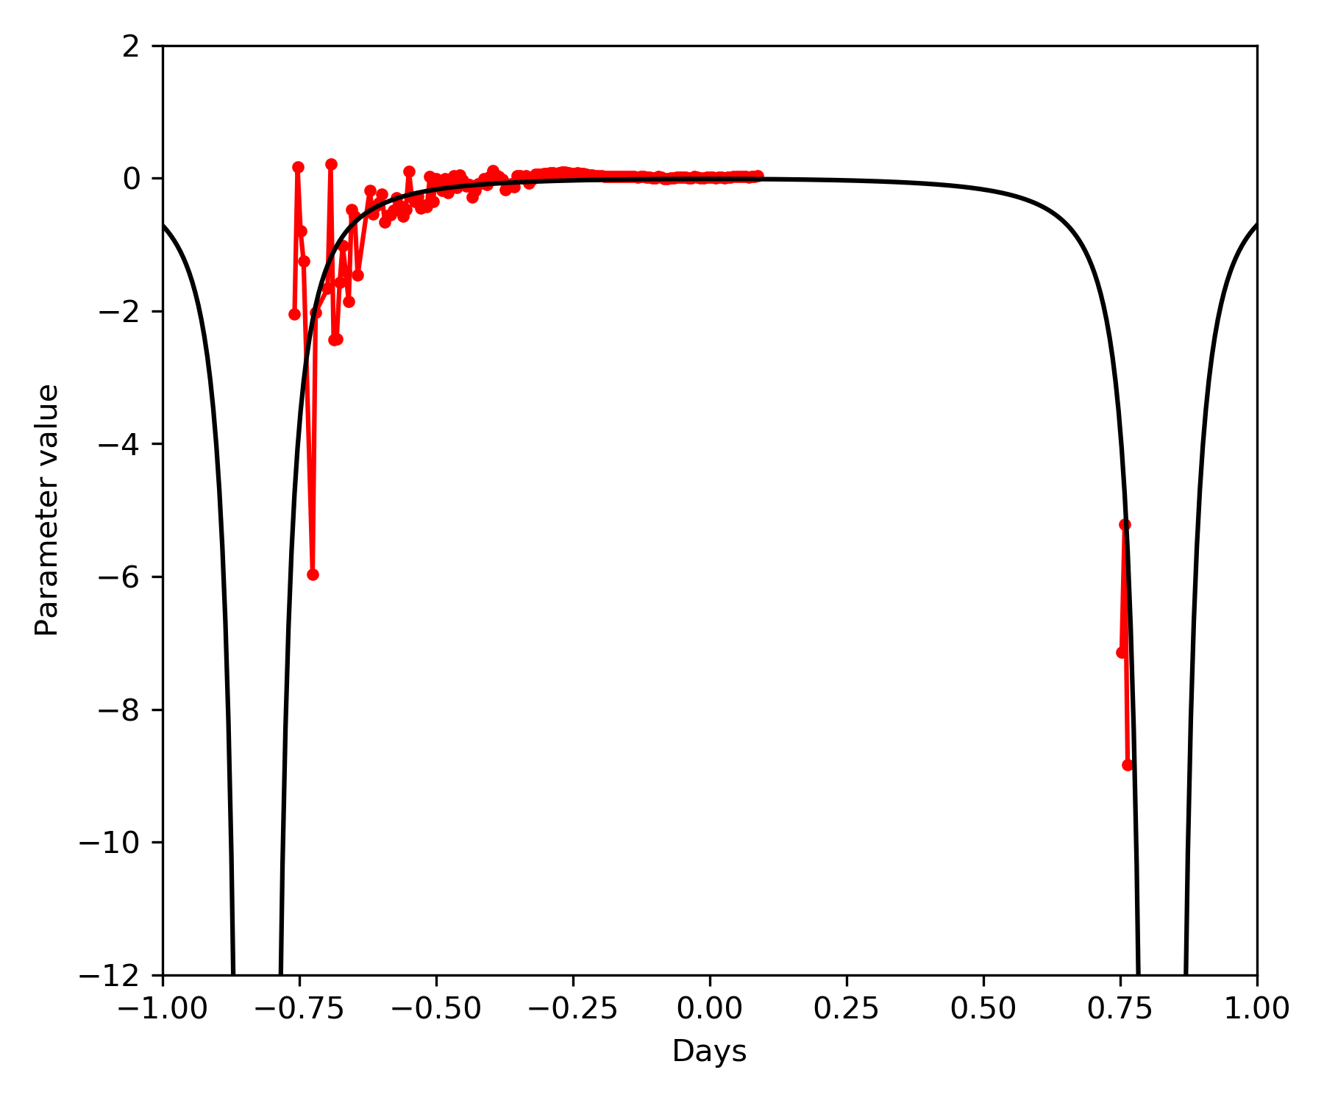
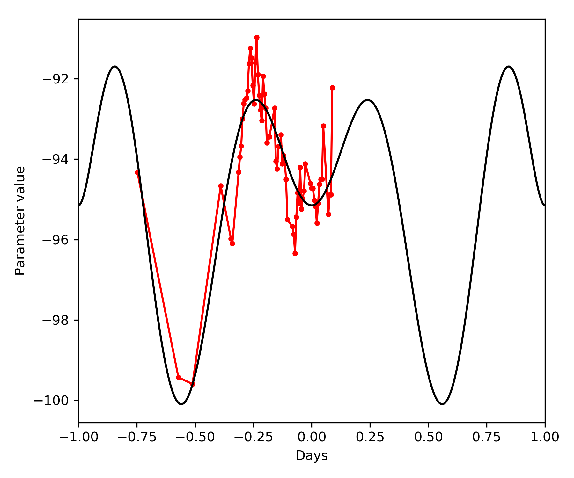
Resulting Model - Components A(DoY) and C(DoY)
A(DoY) = (K + L*DoY^2 + M*DoY^4) * (cos(P/2)+1) + N
Amplitude as 4th order polynomial
Cos as periodic base function
offset
C(DoY) = E * (tan(1.9*DoY))^2 + F
Tan^2 as trigonometric base function
offset
Notes:
Anhang? Zu detailliert?

Slide 22
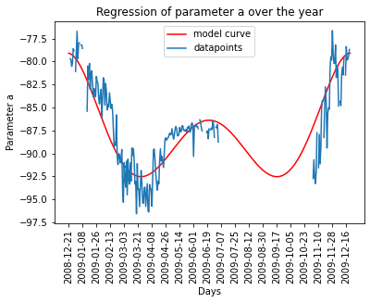
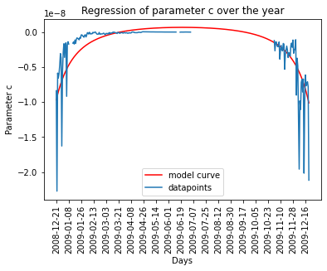
Smooth the seasonal data of NAA

Slide 23
Challenges

Slide 24
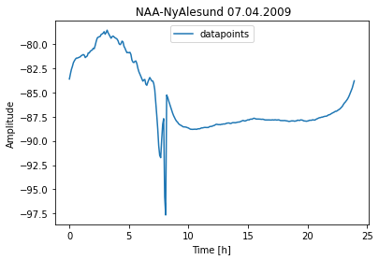
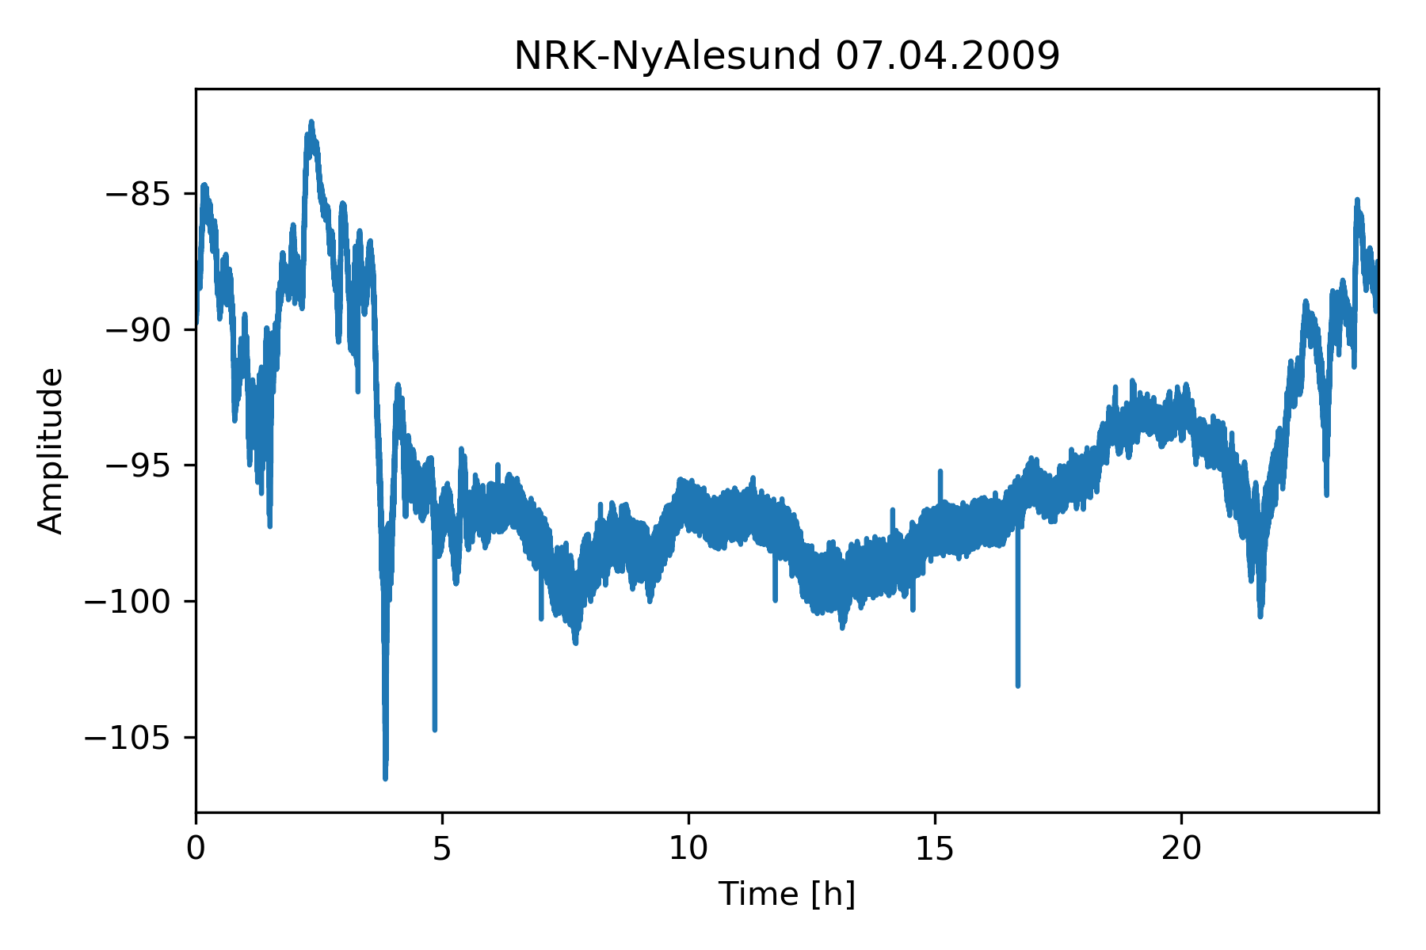
Data Quality
Good Data
Noisy Data

Slide 25
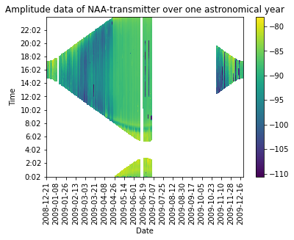
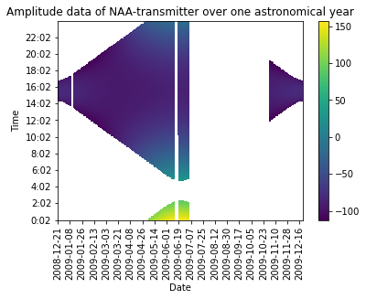
Selection of the fitting function not periodic
Sunrise/ sunset shifted over 0:00 UCT
Model in edge cases not realistic:
Notes:
Periodic function required

Slide 26
Maintenance Windows

Slide 27
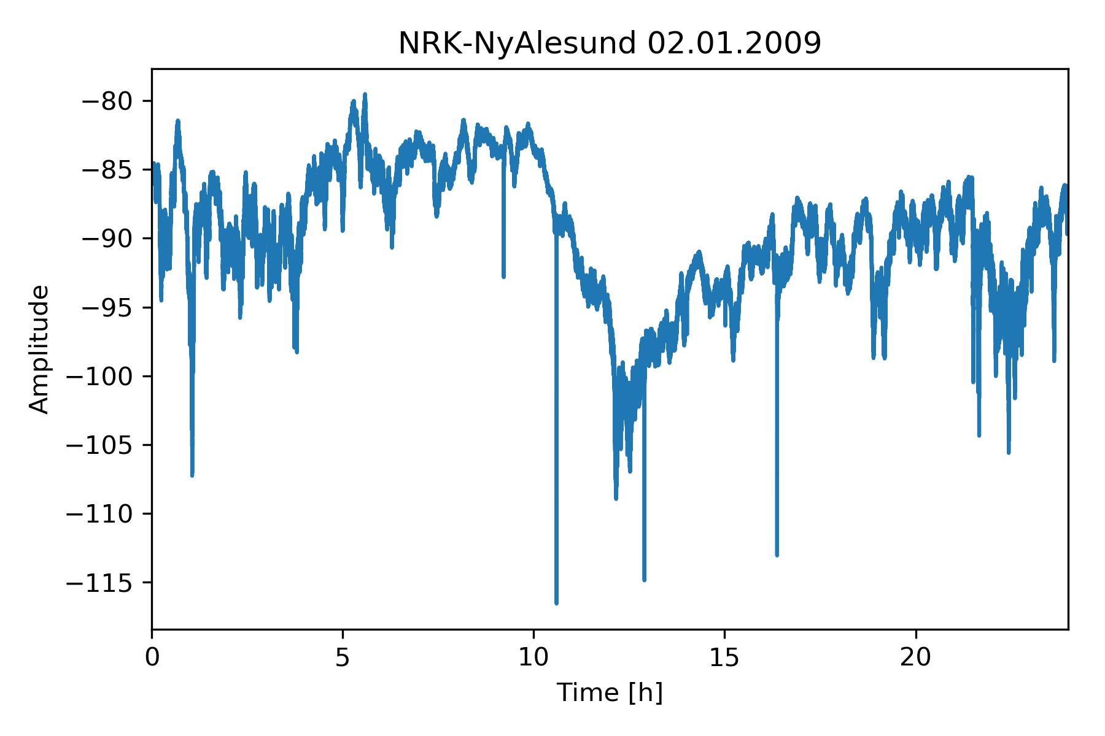
Polar Night and Day

Slide 28

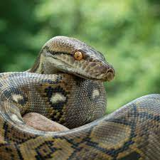
Python

Slide 29
Thank you!

Slide 30
Appendix

Slide 32
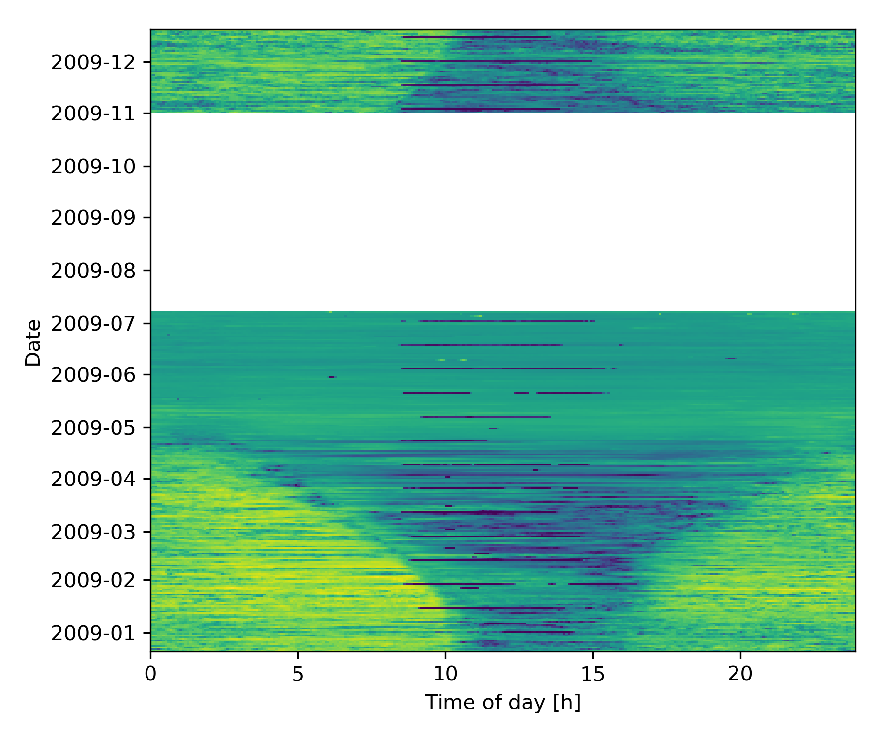
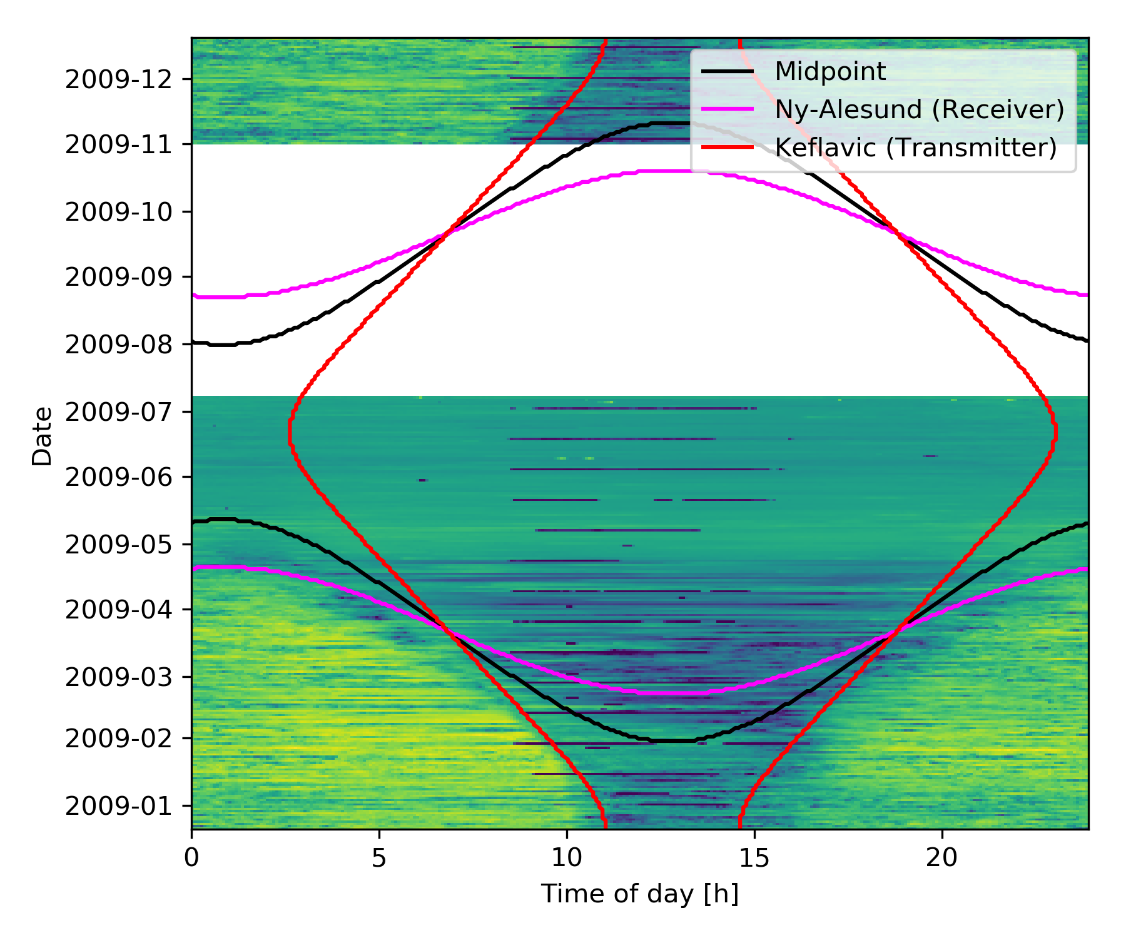
Anhang / Pictures NRK

Slide 33
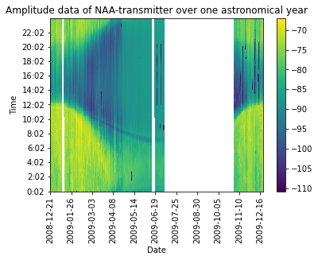
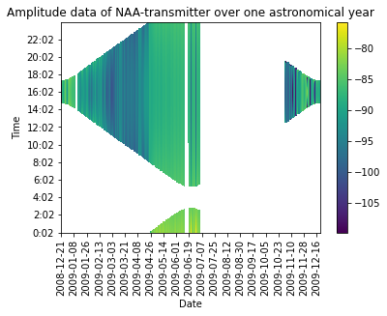
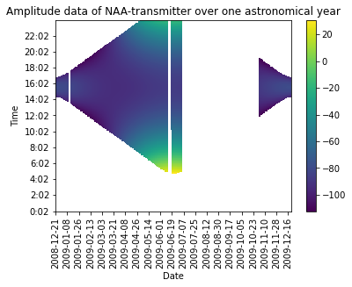
Anhang NAA

Slide 34
